Slide 1
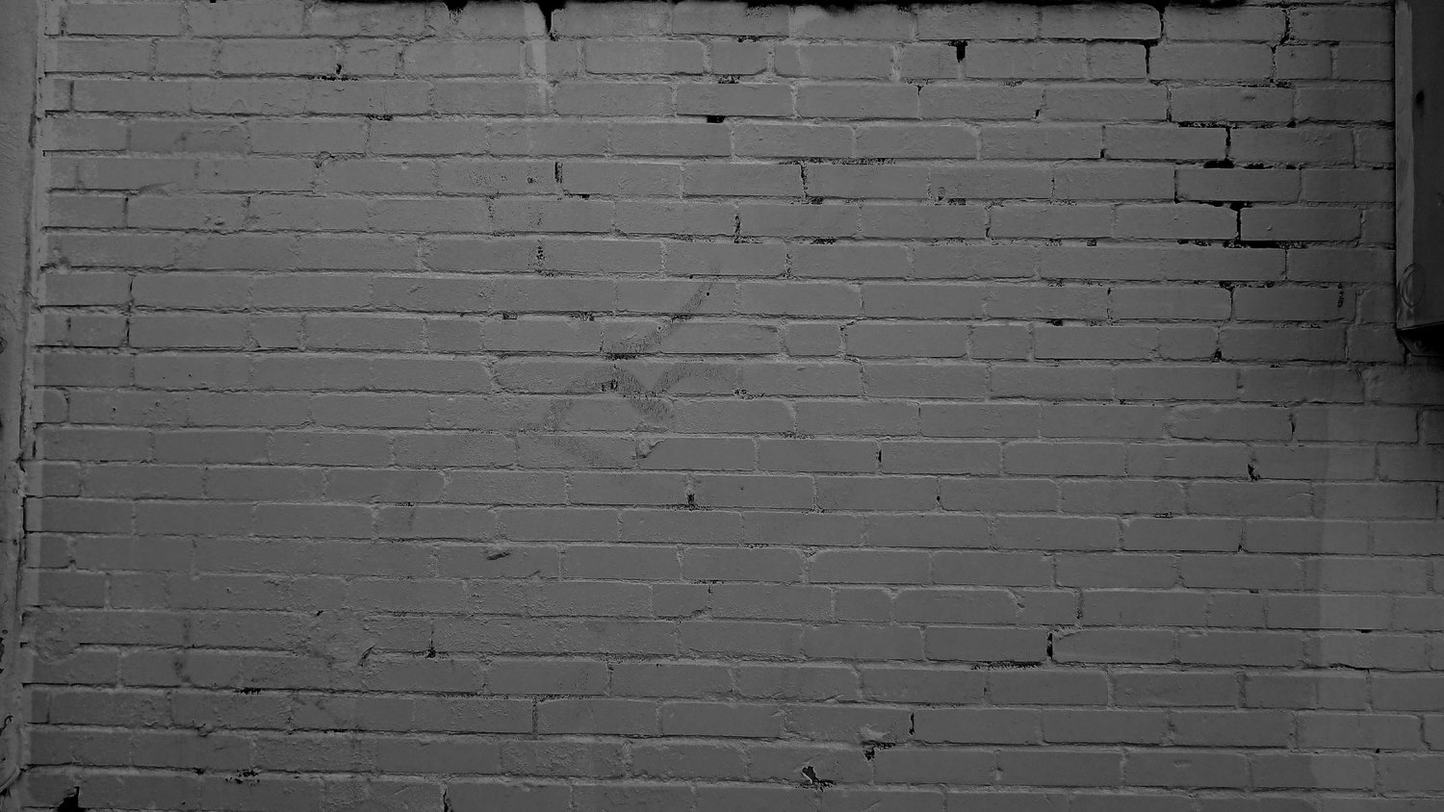


Learning From A Professional Website To Build Your Own Site
CCT360
Professor Ramtin L.
Tuesday, 2PM - 5PM
Date: October 16th 2018
Project #1
Student Name: Syeda Nudrat Zehra
Student Number: 1003433965 (UTM); 991501216 (Sheridan)

Slide 2
Learning From A Professional Website To Build Your Own Site
CCT360
Professor Ramtin L.
Tuesday, 2PM - 5PM
Date: October 16th 2018
Project #1
Student Name: Syeda Nudrat Zehra
Student Number: 1003433965 (UTM); 991501216 (Sheridan)

Slide 3
Assignment Information
Wikipedia Page
Title: “Banksy”
Link: https://en.wikipedia.org/wiki/Banksy
Professional Page:
Title: “UGSMAG”
Link: https://ugsmag.com/

Slide 4
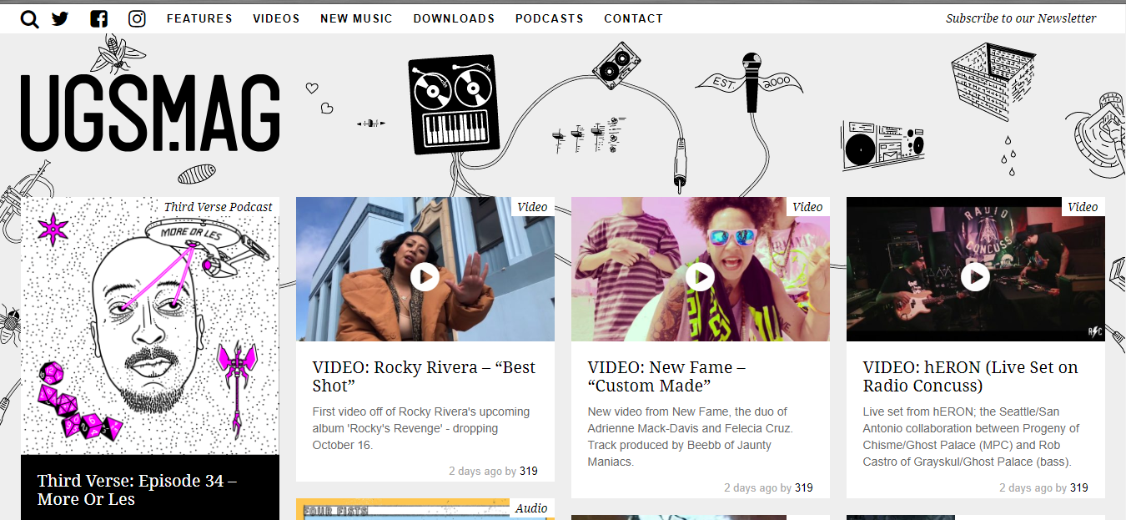
Screenshot of Professional Website
(Homepage)

Slide 5
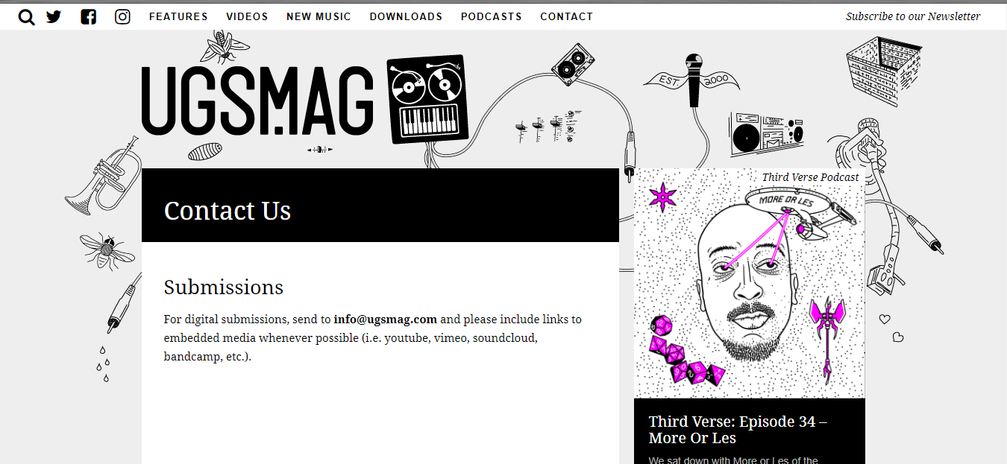
Screenshot of Professional Website
(Inner page - Contact)

Slide 6
Rationale of choice
Wikipedia Page
The idea of graffiti never fails to impress me, whether it is the elements or the textual components. Graffiti artists in particular are creative and innovative with bringing a different type of approach to the arts industry and being able to turn any public wall into an incredible art piece. Banksy, a well-known graffiti artist has established a standard of graffiti art and uses his platform effectively by sometimes creating an artwork that would essentially support a social or political movement. Banksy has also used several opportunities to raise various social issues such as anti-war. Besides the relevance of the topic, the Wikipedia page also fulfils all the requirements that the project outline asks for, such as approximately 1000 words.
Professional Page
UGSMAG was chosen for this particular assignment because of the template. The background in the header is the highlight of the website and the idea aligns with graffiti and wall art. The website also offers space for mostly graphics and less text which is beneficial as Banksy has several artworks to present with a bit of written background on the artwork. The inner page of the UGSMAG that was integrated was “Contact”, because the information provided on Wikipedia needed more space and this page was the most relevant.

Slide 7
Process
Brainstorm
Node-line tree diagram, wireframe, fonts, etc.
Visual Studies

Slide 8


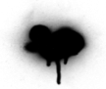
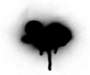
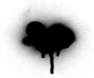





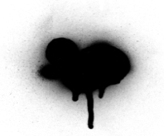







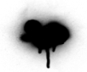
UGSMAG
Process
(Brainstorming)
Fonts and header background
Fonts Suitable For
UGSMAG Theme
BANKSY
UGSMAG
BANKSY
UGSMAG
BANKSY
UGSMAG
BANKSY
Final Logo PNG file
Compilation of online (PNG)images.
To create the header background for all of the HTML pages, around seven PNG, graffiti related files were downloaded from Google, which are saved in the ‘images’ folder.

Slide 9
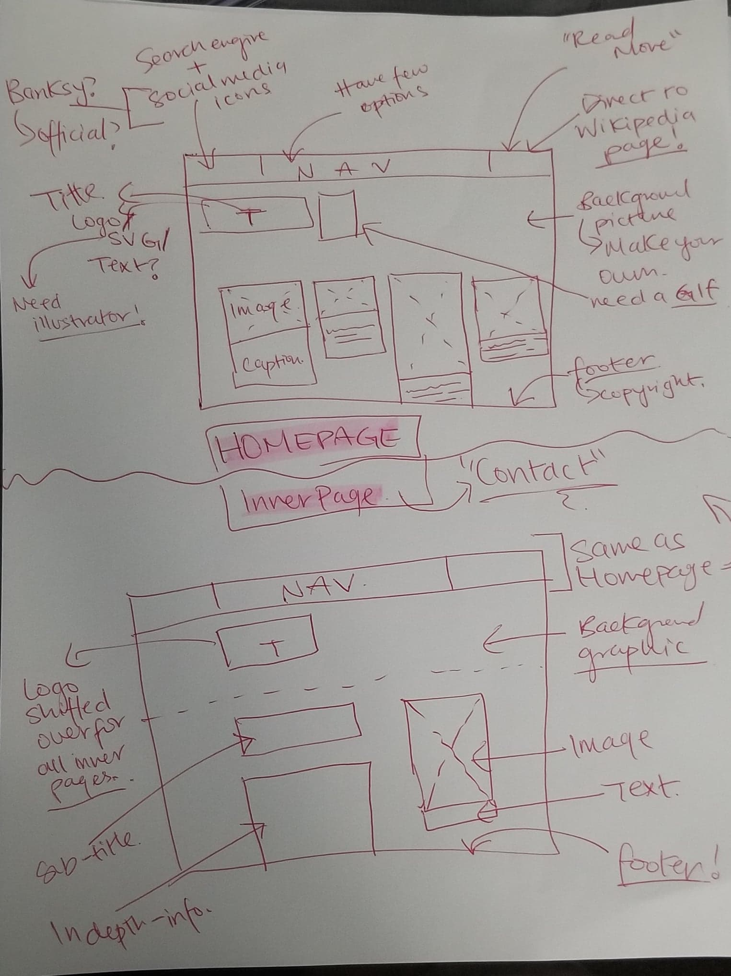
Process
(Brainstorming)
Wireframe - Hardcopy

Slide 10
Process
(Brainstorming)
Non-Modified Node-Link
Early career (1990–2001)
Exhibitions (2002–2003)
£10 notes to Barely Legal (2004–2006)
The Banksy effect (2006–2007)
Personal Life
2008
The Cans Festival (2008)
Career
2009
Cultural Icon
Exit Through the Gift Shop (2010)
2011
Better Out Than In (2013)
Other Notable
Artworks
2012
2013
'Banksy in Gaza' clip
Technique
Dismaland
Banksy
Political and
Social Themes
2015
The Son of a Migrant
from Syria
Criticism
2017
Walled Off Hotel
Bibliography
See Also
Return to New York
2018
References
Balloon Girl shredding
Further Reading
Damaged Artwork
Side note:
Background:
White: whiteboard effect but too bright. Maybe?
Black: too brigt
Lines
Curve or straigt or w/ arrows?
Curvy: looks nicer for a node-link
Colour?: black+white+ 1 colour- pink, hot pink0
External Links
Which
one?

Slide 11
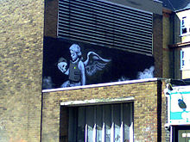
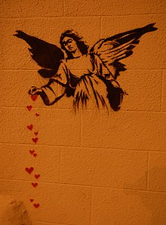
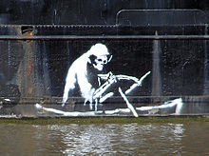
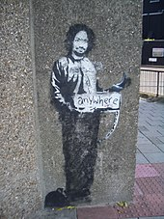
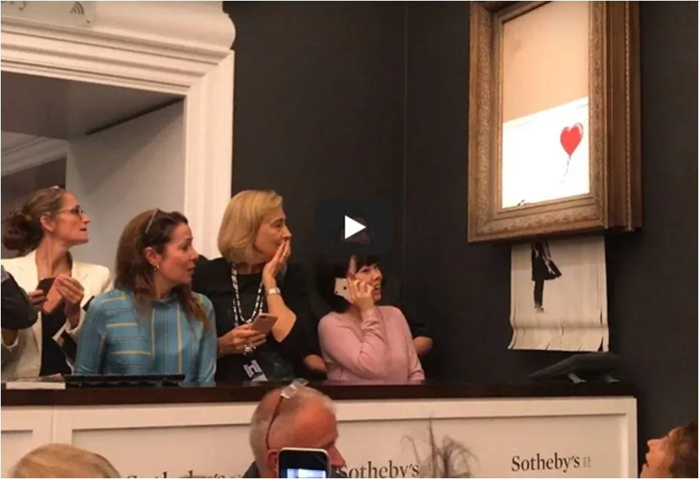
Process
(Visual Studies)
Not sure?
Confirmed list of images
GIF file for the header
Upload the screenshot?

Slide 12
Personas
Two Distinct User Personas

Slide 13

Personas
(Persona #1)
Amanda Tyler
Motivation
As a curator assistant, Amanda’s task is to gather as much street artwork as she can because the “London Street arts” exhibition is in six months. Her boss, the curator of the “Gallery of London” has assigned Amanda this role and has given her deadlines so that the exhibition can be carried out smoothly.
GENDER Female
AGE 25
LOCATION London, England
OCCUPATION Curator Assistant
Goals
Find two authentic artworks by a well-known street artist
Attempt to contact the artist to attend the event
Hoping to receive the original artworks by the end of the following month
According to Amanda, most interesting artist:
Cartrain
0
10
Frustrations
Pressure from curator and senior management to gather artworks ASAP
Banksy, being anonymous, may not show up
Banksy
0
10
Inkie
0
10

Slide 14

Personas
(Persona #2)
Francis Fahim Freud
Motivation
Researching if graffiti is considered as ‘vandalism’ or ‘art’. He needs secondary sources to support his arguments and he is on a time crunch to submit the assignment. He has other commitments to complete, therefore he is in a rush to accumulate all the information and present them as facts .
GENDER Male
AGE 20
LOCATION Yale University (USA)
OCCUPATION Student
Goals
Find other relevant sources, use Yale University database
He is also looking into political related issues in relation to graffiti art
Curate and send emails by the upcoming Friday
According to Fahim, most creative international artist:
Banksy
0
10
Frustrations
Difficult to contact international artists
Busy schedule; soccer scheduled for the evenings
A1one
0
10
MadC
0
10

Slide 15
Information Architecture
Node-Link
(Tree Diagrams)
Non – Modified Content
&
Modified Content

Slide 16
Node-link Tree Diagram
Non-modified Content
Early career (1990–2001)
Exhibitions (2002–2003)
£10 notes to Barely Legal (2004–2006)
The Banksy effect (2006–2007)
Personal Life
2008
The Cans Festival (2008)
Career
2009
Cultural Icon
Exit Through the Gift Shop (2010)
2011
Better Out Than In (2013)
Other Notable
Artworks
2012
2013
'Banksy in Gaza' clip
Technique
Dismaland
Banksy
Political and
Social Themes
2015
The Son of a Migrant
from Syria
Criticism
2017
Walled Off Hotel
Bibliography
See Also
Return to New York
2018
References
Balloon Girl shredding
Further Reading
Damaged Artwork
External Links

Slide 17
Node-link Tree Diagram
modified Content
Personal Life
Banksy
Career
Political Themes

Slide 18
Wireframes
Homepage
&
Inner Content Page

Slide 19
Wireframe
(Homepage)
Search | Navigation Bar
Background (Graphics)
Title (Logo)
Media
Media
Media
Media
Caption
Caption
Caption
Caption
Footer

Slide 20
Wireframe
(Inner Page)
Search | Navigation Bar
Background (Graphics)
Title (Logo)
Sub-title
Media
Content
Caption
Footer

Slide 21
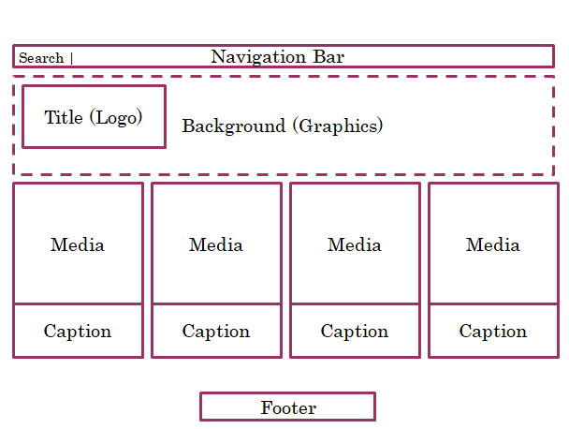
Navigation (Labels)
Utility
Navigation
(Search Engine)
Structural
Navigation
(Global - Menu)
Associative
Navigation
(Footer)

Slide 22
Principles of Usability
Wireframes
The wireframes respond to the personas effectively because the homepage and inner page provide a decent amount of information, specifically about the artwork that both Amanda and Fahim want to learn more about. The homepage illustrates a wide amount of artworks that Amanda can choose from, to display in the exhibition. On the other hand, Fahim is essentially looking at the political related artworks displayed in the navigation bar.
Information Architecture: Node-links
The modified node-link of the Wikipedia page was purposely designed in such way that it can assist the users to find what they are looking for easily. Otherwise, the non-modified node-link consists of a lot of information that the user may get confused and may not want to invest more time to explore the site.

Slide 23
References
12 Grunge Spray X (PNG Transparent). (n.d.). Retrieved from http://www.onlygfx.com/26-grunge-spray-paint-stroke-banner-png-transparent-svg/
Spray Splatter Hi-res . (n.d.). Retrieved from https://images.vectorhq.com/images/previews/d01/spray-splatter-hi-res-psd-462517.png
26 Grunge Spray Paint Stroke Banner . (n.d.). Retrieved from https://mbtskoudsalg.com/images/spray-paint-drip-png-4.png
15 Transparent spraypaint clip art free for download .(n.d.). Retrieved from
https://ubisafe.org/explore/transparent-spraypaint-clip-art/
Flaticon. (n.d.). Retrieved from https://www.flaticon.es/icono-gratis/usuario_219984
Brithouse. n.d.). Retrieved from http://brithouse.ru/profile/imranmurtazov/
https://en.wikipedia.org/wiki/Banksy
https://ugsmag.com/

